Slide 1
ToDo
Picture hunting
Rainbow for overlapping ships
Bubble wrap icon
Powerups buoy
Low Priority:
When a player is removed
animation for their card to slide off the bottom of the screen
Animation to remove them from the chat tabs

Slide 2
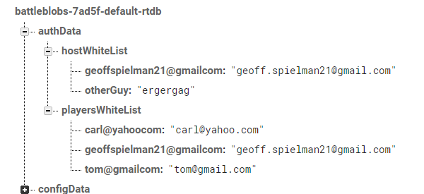
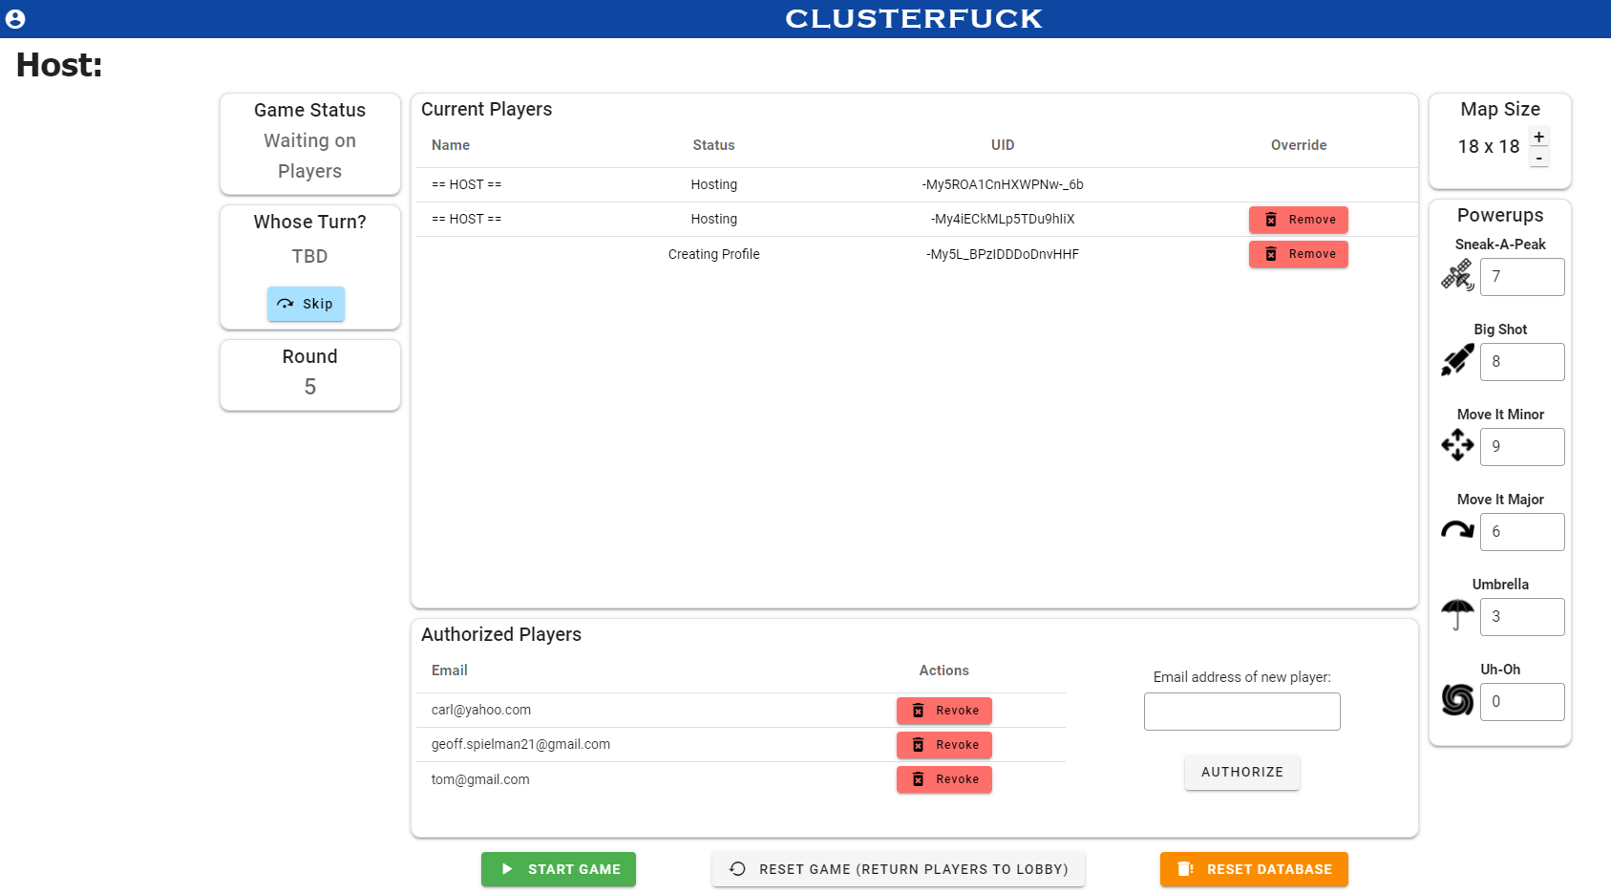
To Do
use UID
List index starts as ‘stripped’ email address, then gets updated to UID after sign in
Add UID

Slide 3
LANDING PAGE

Slide 4




Welcome to
Geoff Spielman’s
CLUSTERFUCK
TM
Learn How to Play
Skip to Lobby
Copyright © 2021 Geoff Spielman
Powered by:
Sourcecode:

Slide 5
_{TM}
CLUSTERFUCK
Welcome to
Geoff Spielman’s
Learn How to Play
Skip to Lobby

Slide 6
CLUSTERFUCK CLUSTERFUCK CLUSTERFUCK CLUSTERFUCK CLUSTERFUCK CLUSTERFUCK CLUSTERFUCK CLUSTERFUCK CLUSTERFUCK CLUSTERFUCK
CLUSTERFUCK CLUSTERFUCK CLUSTERFUCK

Slide 7
Welcome to Welcome to Welcome to Welcome to Welcome to Welcome to Welcome to Welcome to Welcome to

Slide 8
INSTRUCTIONS

Slide 9



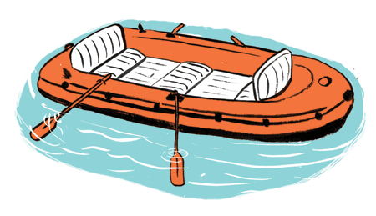



CLUSTERFUCK
TM
This game is similar to battleship, except…
Everyone’s ships are on the same map
You design your own ships
There is an anonymous chat window for strategizing, forming alliances, and treachery
There are power-ups
There are lifeboats
Previous
Next

Slide 10

CLUSTERFUCK
TM
Gameplay:
Each player designs two ships
Ships consist of 9 squares connected by common edges (corners don’t count)
ü
ü
x
x
Your ships will be randomly placed on the map
When the game begins you will see your ships but the rest of the map is hidden under fog
Each turn you can either fire a shot or use a power-up
A round ends when each player has taken their turn
Previous
Next

Slide 11


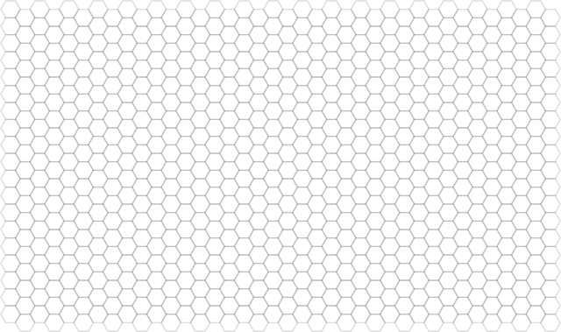

CLUSTERFUCK
TM
Power-ups:
Powerups are discovered by missing everyone’s ships but hitting a lovely buoy drifting out at sea instead
You can only hold 3 power ups at a time. Upon discovering your fourth you must immediately discard one.
Big Shot
Bubble Wrap
Sneak-a-Peek
 | ?
 | ?
 | ?
 | ?
 | ?
This military grade bubble wrap protects your entire ship for one round. These bubbles do not pop – shots simply bounce off.
Your shot covers 4 squares this turn. Way to go champo!
Reveals what lies beneath five squares of fog. Other players know where you looked but not what you can saw.
Previous
Next

Slide 12


CLUSTERFUCK
TM
Power-ups:
Powerups are discovered by missing everyone’s ships but hitting a lovely buoy drifting out at sea instead
You can only hold 3 power ups at a time. Upon discovering your fourth you must immediately discard one.
Move it Minor
Move it Major
God Mode
Allows you to shift one square in any direction.
Allows you to teleport one of your ships to anywhere on the map and reorient it as you please.
The ‘cool down’ limitation on your sound board is removed. Please have mercy.
Moving caveat: if you move under fog (probably a good idea) and an opponent hits one of your already damaged segments, that opponent gets another shot
Previous
Next

Slide 13
CLUSTERFUCK
TM
Game Interface
Previous
Next

Slide 14

CLUSTERFUCK
TM
Lifeboats
If you last ship only has two segments remaining, you will see a pop-up asking if you’d like to deploy your lifeboat
Would you like to send out a lifeboat?
You can decline and stay with your last ship to the bitter end
Or
You can select another player and send your lifeboat toward them.
The selected player can either accept or decline your lifeboat
No! Captain goes down with their ship
Yes, send it to
Lord Farquad
^
Deploy
If accepted
Two squares of your colour will be attached to their ship. The algorithm attempts to place your squares under fog and away from other ships, but this is not always possible.
You continue taking your turns as usual. Using the ‘bubble wrap’ powerup will cover your lifeboat and your friends connected ship.
This is why making friends is important ☺
If declined
Your lifeboat is met with a barrage of cannon fire and you die immediately.
This is why treachery is fun ☺
Previous
Next

Slide 15
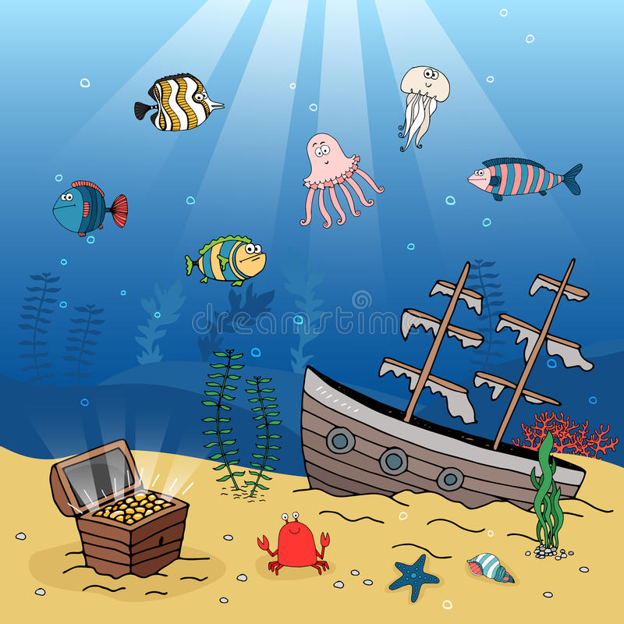
CLUSTERFUCK
TM
End Game
Once your last ship sinks, you’re dead.
All of your turns are skipped
You can’t send messages in the anonymous chat window anymore
The last player with a ship afloat wins
Once the game is over you will be presented with a list of all aliases and each player’s real name. Match them up to the best of your ability.
If only one person gets all the matches correct, they will receive a special bonus prize going into the next game.
Previous
Next

Slide 16
LOBBY

Slide 17
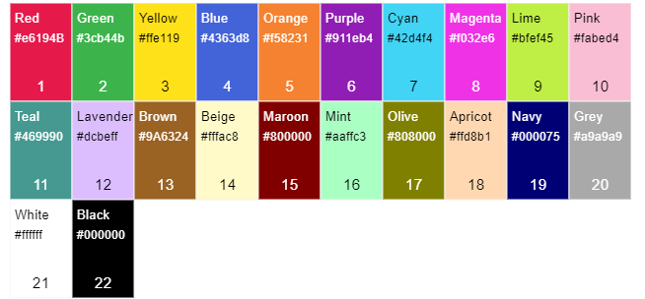


CLUSTERFUCK
TM
Lobby
Taken
Name:
Colour:
Taken
Revealed at the end of the game to determine the bonus prize winner
Please use your real name, it helps troubleshoot connection issues ☺
Alias:
Enter your own or pick from the bank below:
Taken
Lord Farquad
Darth Evader
Dumking aeffeaf
Fleet:
✓
4/8 squares
Ready
4 players are ready to start

Slide 18


CLUSTERFUCK
TM
Lobby
Name:
Colour:
Revealed at the end of the game to determine the bonus prize winner
Please use your real name, it helps troubleshoot connection issues ☺
Taken
Taken
Alias:
Taken
Enter your own or pick from the bank below:
Fleet:
Lord Farquad
Darth Evader
Dumking aeffeaf
✓
✓
Locked In
I changed my mind
5 players are ready to start

Slide 19



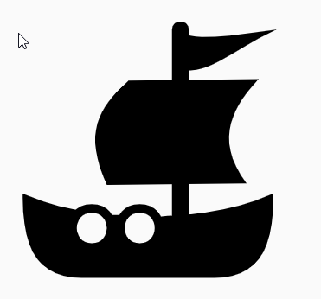

Slide 21
REJOIN

Slide 22
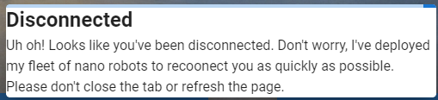
Connection Lost
Uh oh! You have been disconnected from the game. Don't worry, I've deployed my fleet of nano robots to reconnect you as quickly as possible. Please don't close this tab or refresh the page.
Connection Lost
Uh oh! You have been disconnected from the game. Don't worry, I've deployed my fleet of nano robots to reconnect you as quickly as possible. Please don't close this tab or refresh the page.

Slide 23
CLUSTERFUCK
Game is in progress, user clicked ‘skip to lobby’:
TM
There is currently a game in progress. Would you like to…
Join with only 1 ship
Spectate until the next game
Rejoin (you were disconnected)
Back to Main Menu

Slide 24
CLUSTERFUCK
User chose “Rejoin”:
TM
Welcome back!
Who are you?
List of disconnected players:
Disconnected Player 1
Disconnected Player 2
Disconnected Player 3
Rejoin Game
The Host Gave Me a Key
Only shows up when the user clicks the button:
Rejoin
Back to Lobby Options

Slide 25
GAME

Slide 26
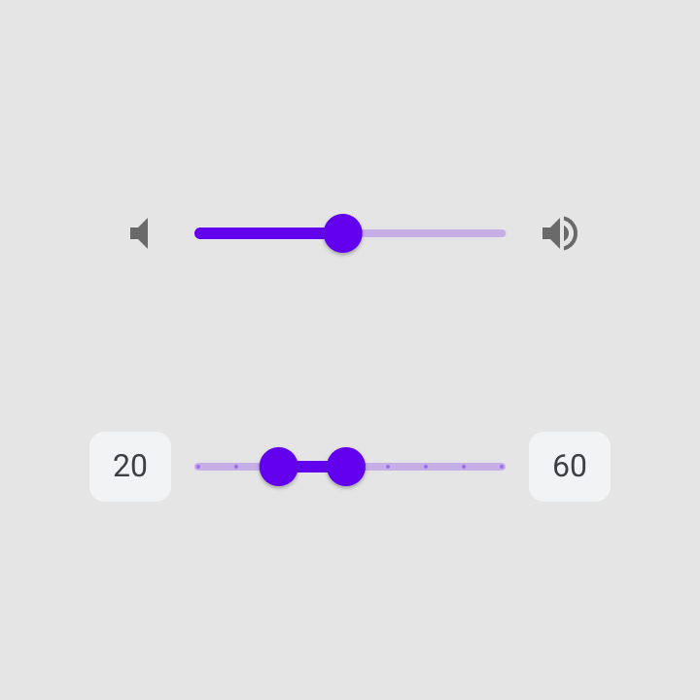


Elastagirl: yeah that would be good
Lord Farquaad: No!
Inigo Montoya: This game is bullshit, I blame Elastagirl
Remaining:
Sneak-A-Peak
2/3
Bubble Wrap
4/5
Big Shot
1/2
Move-it Minor
2/3
Move-it Major
1/4
Send
Uh-Oh
Soundboard 0:45
0/1
Ellie Woods
Elastigirl
Darth Evader
Lord Farquaad
Inigo Montoya
Ron Weasely
Poke-ah the Hut
Dorothy Gale

Slide 27
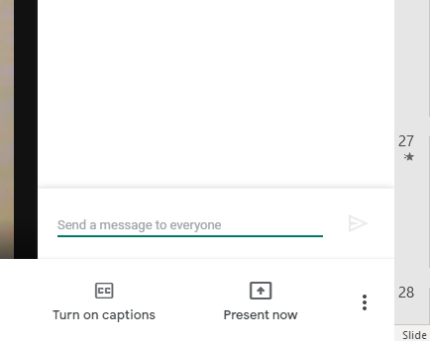
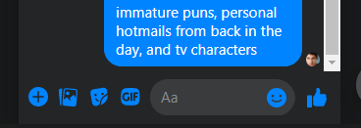

PUBLIC CHAT
Elastigirl: yeah that would be good
Lord Farquaad: No!
Inigo Montoya: This game is bullshit, I blame Elastigirl
Public
Remaining:
Sneak-A-Peak
2/3
Ellie Woods
Bubble Wrap
4/5
Elastigirl
Big Shot
1/2
Move-it Minor
2/3
Move-it Major
1/4
God Mode
Send
0/1
Settings
Ellie Woods
Elastigirl
Darth Evader
Lord Farquaad
Inigo Montoya
Ron Weasely
Poke-ah the Hut
Dorothy Gale

Slide 28
PRIVATE CHAT WITH ELLIE WOODS
Remaining:
Public
Sneak-A-Peak
Agree to be my lifeboat?
2/3
Okay
Ellie Woods
Bubble Wrap
4/5
Elastigirl
Big Shot
1/2
Move-it Minor
2/3
Move-it Major
1/4
Send
God Mode
0/1
Settings
Ellie Woods
Elastigirl
Darth Evader
Lord Farquaad
Inigo Montoya
Ron Weasely
Poke-ah the Hut
Dorothy Gale

Slide 29
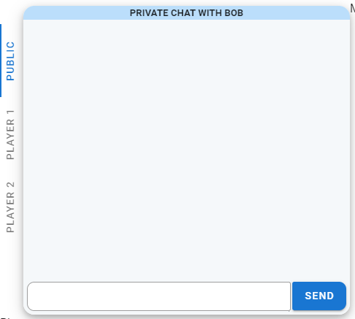
PUBLIC CHAT
Player 1 Alias
Alliance ?
Hey who shot at me?
Player 2 Alias
Yeah alright
Definitely wasn’t me, I’m Ghandi!
Hehe ;)

Slide 30
Elastagirl: yeah that would be good
Lord Farquaad: No!
Inigo Montoya: This game is bullshit, I blame Elastagirl
Lord Farquaad deployed Bubble Wrap
Ron Weasely: Oh great, just what we needed
Remaining:
HOVER OVER ‘MOVE IT MINOR’:
Sneak-A-Peak
2/3
Bubble Wrap
4/5
Big Shot
Move it Minor
1/2
Move-it Minor
2/3
Move-it Major
Allows you to shift one square in any direction.
1/4
God Mode
Sound board 0:45
0/1
Ellie Woods
Elastigirl
Darth Evader
Lord Farquaad
Inigo Montoya
Ron Weasely
Poke-ah the Hut
Dorothy Gale

Slide 31









Noun Project Search (thenounproject.com)
Noun Project Search (thenounproject.com)
Noun Project Search (thenounproject.com)
Noun Project Search (thenounproject.com)
Noun Project Search (thenounproject.com)
Noun Project Search (thenounproject.com)
Noun Project Search (thenounproject.com)
Noun Project Search (thenounproject.com)
Noun Project Search (thenounproject.com)

Slide 32




Noun Project Search (thenounproject.com)
Noun Project Search (thenounproject.com)
Noun Project Search (thenounproject.com)
Noun Project Search (thenounproject.com)

Slide 33




Noun Project Search (thenounproject.com)
Noun Project Search (thenounproject.com)
Noun Project Search (thenounproject.com)
Noun Project Search (thenounproject.com)

Slide 34



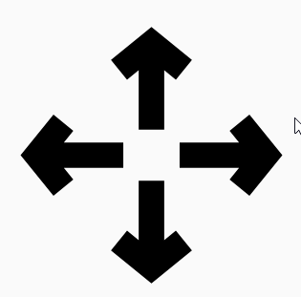


Noun Project Search (thenounproject.com)
Noun Project Search (thenounproject.com)
Noun Project Search (thenounproject.com)
Noun Project Search (thenounproject.com)
Noun Project Search (thenounproject.com)
Noun Project Search (thenounproject.com)

Slide 35




Noun Project Search (thenounproject.com)
Noun Project Search (thenounproject.com)
Noun Project Search (thenounproject.com)
Noun Project Search (thenounproject.com)

Slide 36



Noun Project Search (thenounproject.com)
Noun Project Search (thenounproject.com)
Noun Project Search (thenounproject.com)

Slide 37
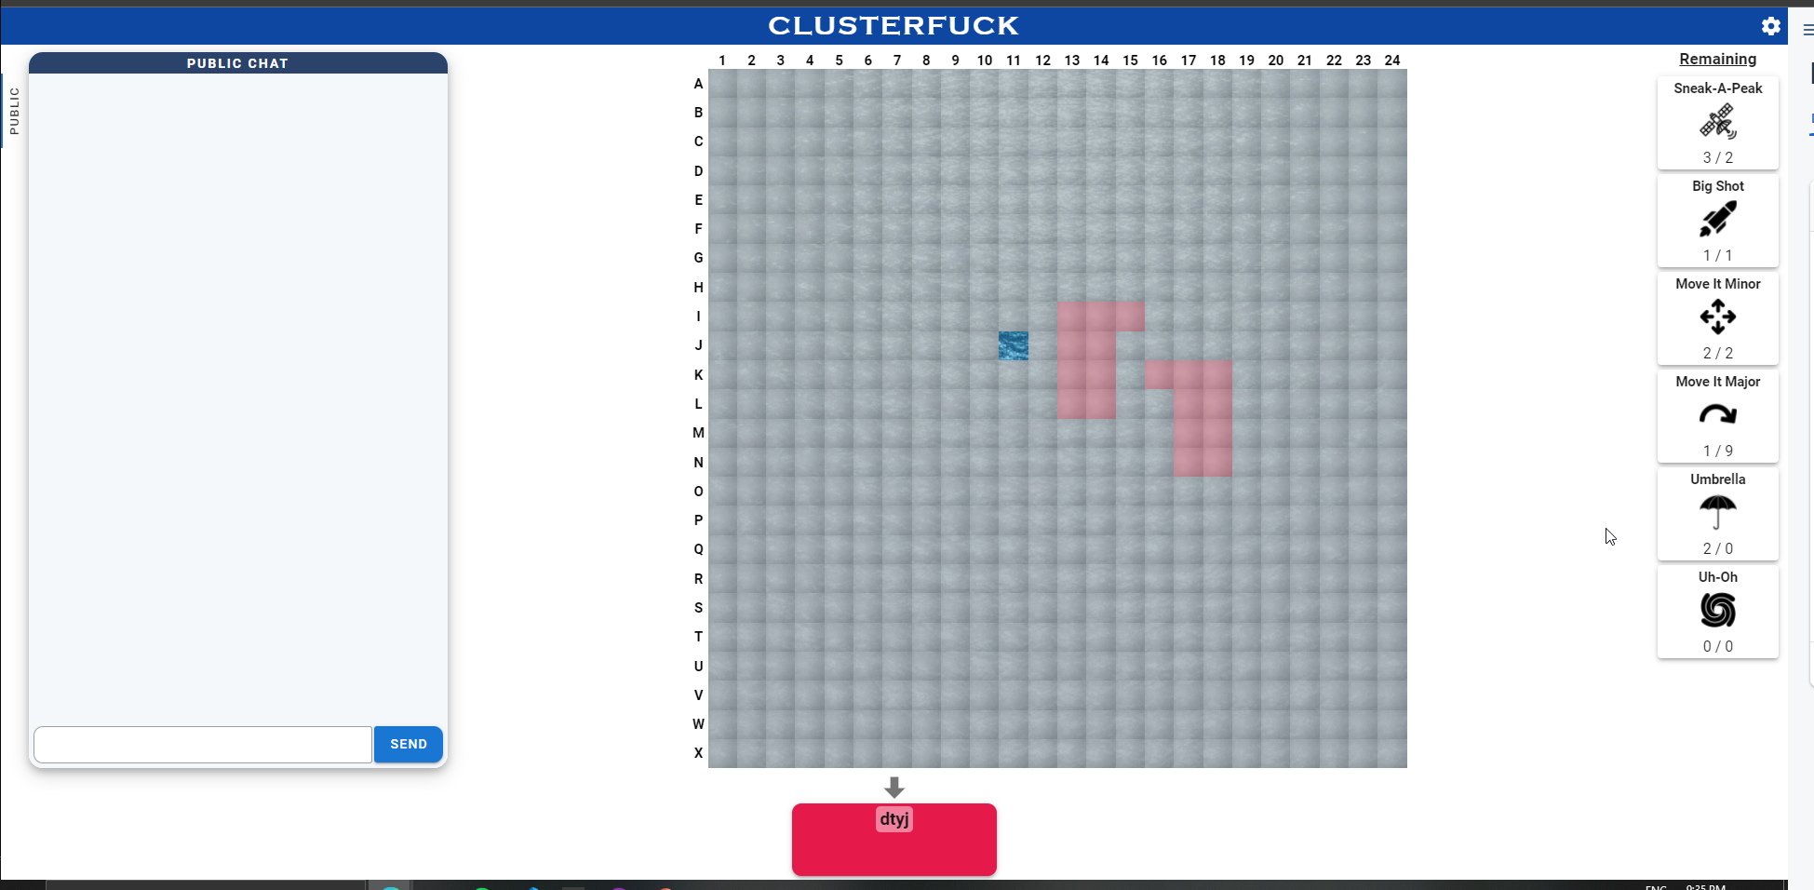
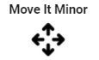

Slide 39
HOST

Slide 40
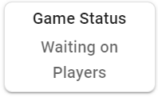
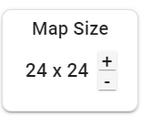
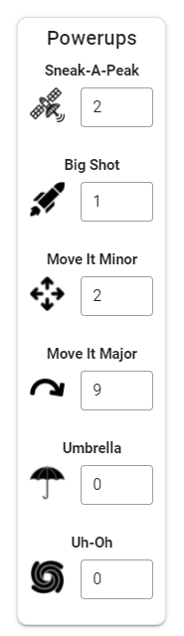
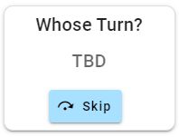
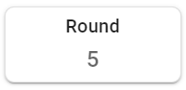

Current Players
Show UID:
Name | Status | Override
Authorized Players
Email | Action
 | Reset password
 | Delete account
Email address of new player:
Authorize

Slide 41
Game in Progress

Slide 42
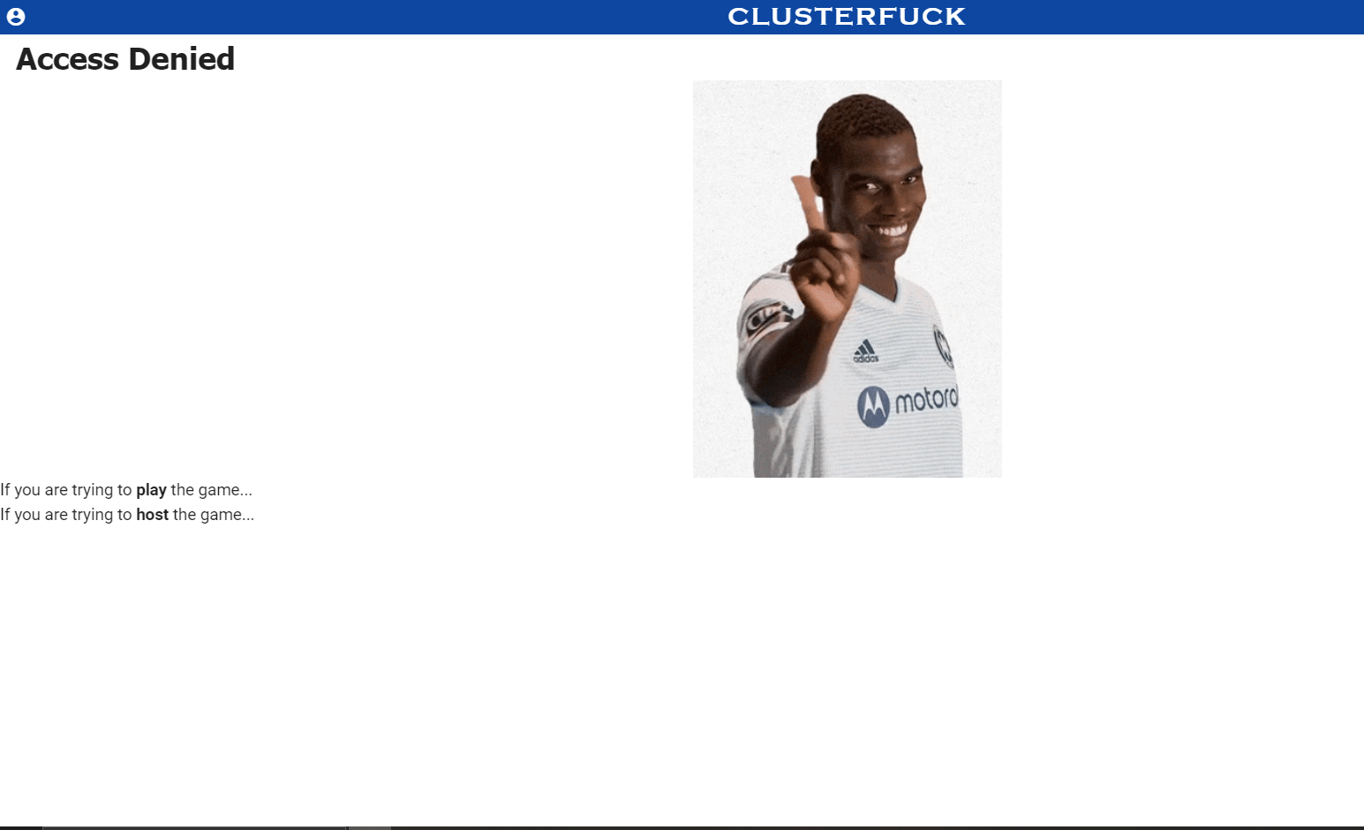

Game in Progress
There is a game in progress right now. Would you like to…
Join game with 1 ship (half of the ships have already been revealed)
Join game (no ships have been revealed yet)
Watch as a spectator. You can see the map and the public chat.
Wait in the lobby for the next game.
Return to the start screen (you can peruse the instructions/credits while you wait)
Select

Slide 43
Not Part of Game

Slide 44
CLUSTERFUCK
TM
FLEET POSSIBLE ERROR MESSAGES:
✓
4/8 squares
Please remove 1 segment
Please remove 2 segments
All segments must be adjacent to at least one other segment

Slide 45
Algorithm: Placing Ships on the Grid
collision detection - Algorithm to fit shapes to 2D grid? - Game Development Stack Exchange
I call this "Place-and-Grow" for lack of having seen a better term elsewhere.
Select a single pixel/cell of your bitmap/source grid to place -- I would start with the centremost pixel. Randomly pick a position in your bacgkround bitmap / destination grid, to place it on. Keep randomising till you find an open space (this process can be optimised in other ways).
If it is now overlapping a solid pixel eg. on the left side, push it out in the opposite direction instead (same applies vice versa and for top/bottom). If you now find it in an empty space once more, you're good to go to the next step. "Grow" the pixel in in all 8 directions around itself, in terms of the source grid / bitmap. Then go back and repeat the shifting step to ensure it's not overlapping anything. Rinse, repeat.
Eventually you will get to a point where either your image is completely drawn in to background space, or you cannot expand it anymore in any direction, and will have to try again.
Basically this approach is described as "physical" because you are pushing away from any boundaries you meet -- until such time as the algorithm is done or it falls out because there is no space on any side to push out toward.

Slide 46

Host Screen:
Next Round:
Sneak-A-Peak
Map Size:
14 x 14
^
>
3
^
Name | Status | Key | Overrides
Thomas | Reading Instructions | wer92345few8923
Garrett | Creating Profile | agfewfafefwfefw3
Chris | Ready to Start | Wer92345few8923
Isaiah | Ready to Start | W343445few8923
>
Whose Turn:
Ellie Woods
Soundboard Cooldown (seconds):
Bubble Wrap
Skip
Remove
Skip
Remove
50
3
^
>
Skip
Remove
Big Shot
Round:
5
Skip
Remove
3
^
>
Move-it Minor
3
^
>
Move-it Major
3
^
>
Start Game
Reset Game (Return Players to Lobby)
God Mode
3
^
Game Status: Waiting for Players
>

Slide 47
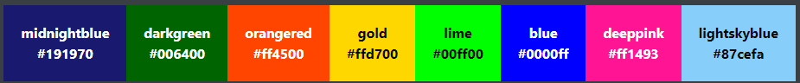
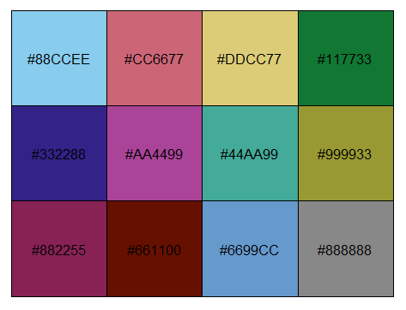
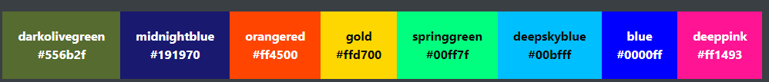
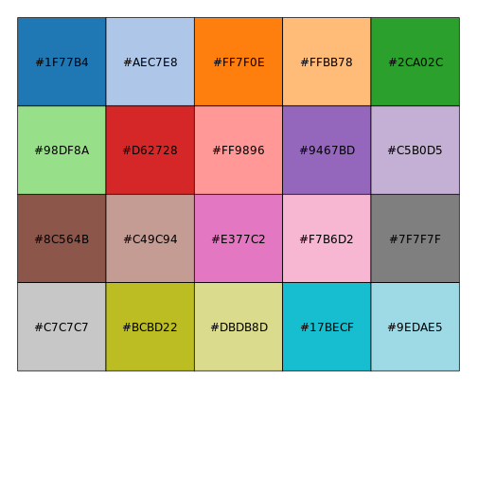

Slide 48
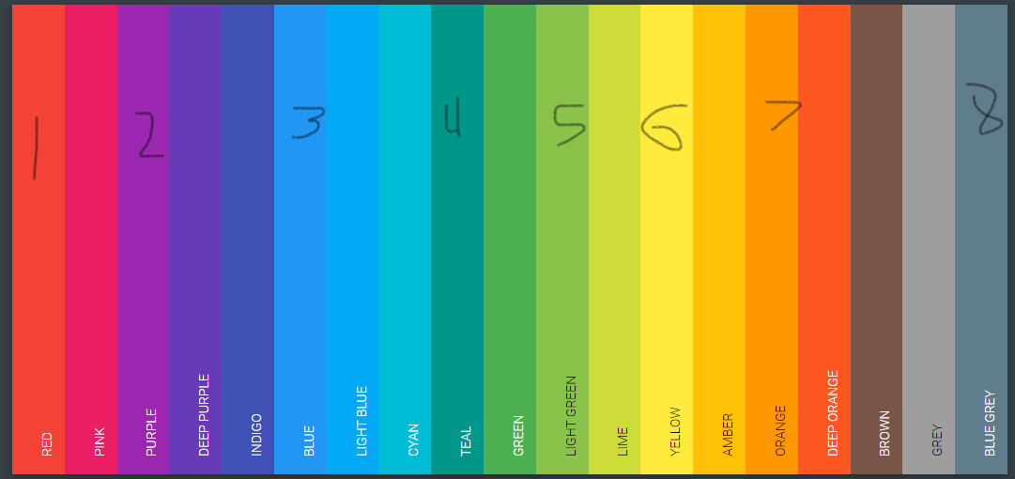

Slide 49

Azure sea_200118 uploaded by 𝐆𝐄𝐘𝐀 𝐒𝐇𝐕𝐄𝐂𝐎𝐕𝐀 👣 on We Heart It
4k Bird's Eye View GIF by Groovy Trips | Gfycat

Slide 50
Azure sea_200118 uploaded by 𝐆𝐄𝐘𝐀 𝐒𝐇𝐕𝐄𝐂𝐎𝐕𝐀 👣 on We Heart It
4k Bird's Eye View GIF by Groovy Trips | Gfycat

Slide 51

#FF7600
#FFFFA7
Taken

Slide 52
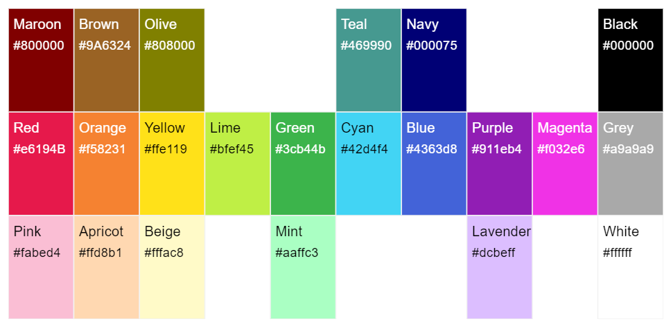
Piss

Slide 53


Download Grey Smoke Transparent Image - Fog | Transparent PNG Download | SeekPNG
Download Fog Clipart Transparent Background - Tree, HD Png Download - PngFind

Slide 54

Download Fog Clipart Transparent Background - Tree, HD Png Download - PngFind
Chosen one:
White Fog Isolated On Dark Transparent Background - Portable Network Graphics - Full Size PNG Clipart Images Download (clipartmax.com)

Slide 55
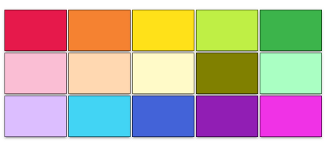

Slide 56
Rules/Arbitrary Design Decisions
Number of players: 2 – 6
Max number of power ups a player can hold: 3
Maximum map size: 24
Minimum map size: 8

Slide 57
SHIP PLACING ALGORITHM UI
Grid square.val: 0 = water
1 = ship(s)
2 = powerup
Ships to place (blanks are ignored):
ID: 0
`
5/9
rowMin:
rowMax:
colMin:
colMax:
1:
2:
3:
4:
5:
[0,0], [0,1], [1,1], [1,3]…
[0,0], [0,1], [1,1], [1,3]…
[0,0], [0,1], [1,1], [1,3]…
[0,0], [0,1], [1,1], [1,3]…
[0,0], [0,1], [1,1], [1,3]…
[0,0], [0,1], [1,1], [1,3]…
rowMin: colMin:
rowMax: colMax:
rowMin: colMin:
rowMax: colMax:
rowMin: colMin:
rowMax: colMax:
rowMin: colMin:
rowMax: colMax:
rowMin: colMin:
rowMax: colMax:
Status:
Actions:
numRows:
numCols:
maxShipDim:
Next drop point: _____
Reset

Slide 58
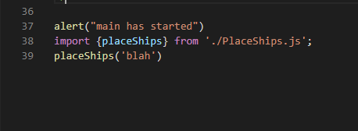
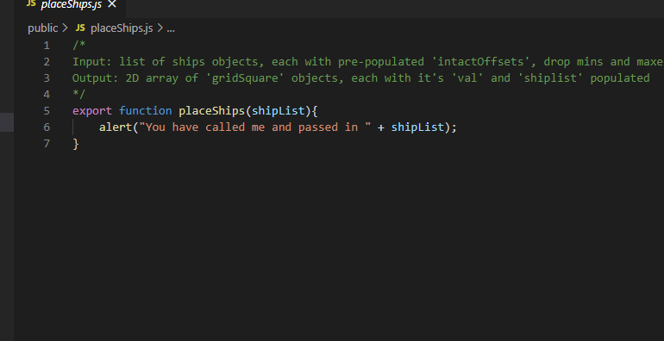
SHIP PLACING ALGORITHM UI
Grid square.val: 0 = water
1 = ship(s)
2 = powerup
Ships to place (blanks are ignored):
ID: 0
`
5/9
rowMin:
rowMax:
colMin:
colMax:
1:
2:
3:
4:
5:
[0,0], [0,1], [1,1], [1,3]…
[0,0], [0,1], [1,1], [1,3]…
[0,0], [0,1], [1,1], [1,3]…
[0,0], [0,1], [1,1], [1,3]…
[0,0], [0,1], [1,1], [1,3]…
[0,0], [0,1], [1,1], [1,3]…
rowMin: colMin:
rowMax: colMax:
rowMin: colMin:
rowMax: colMax:
rowMin: colMin:
rowMax: colMax:
rowMin: colMin:
rowMax: colMax:
rowMin: colMin:
rowMax: colMax:
numRows:
numCols:
Reset

Slide 59
Pages Flow
Arrive at home page
Click either button
Database
Client
New entry pushed into players list, key stores in local variable myKey
2352525: {
name: null
status: “Reading Instructions” | “Creating Profile”
everything else: null
}
myKey = 2352525
Player navigates to host page
Player navigates to lobby page
Database status is updated to “Creating Profile”, host screen reacts
Subscribe to changes in players object
Player selects a colour
Player selects an alias
Focus leaves the ‘name’ text box
players(myKey).name property is updated, host screen reacts
lobbyDynamicOptions. colours property is updated, all lobby screens react
lobbyDynamicOptions .aliases property is updated, all lobby screens react

Slide 60
Disconnect Flows
Client Closes the Tab or Clicks Refresh
Window object’s ‘before unload’ event fires
Change status to “Left Game”
Player rejoins
Change status to “In Game”, send them their key old key, delete players entry for their current key

Slide 61
Authentication

Slide 62
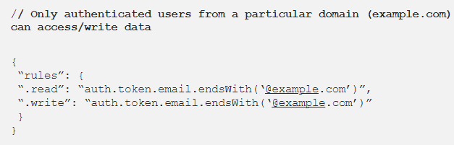
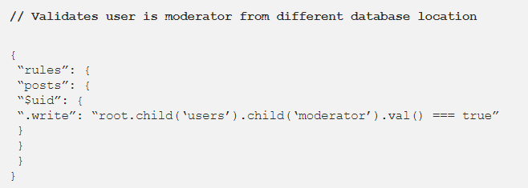
10 Firebase Realtime Database Rule Templates

Slide 63
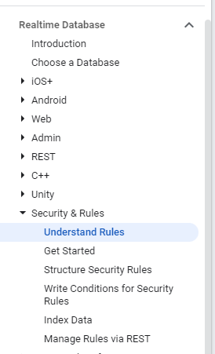
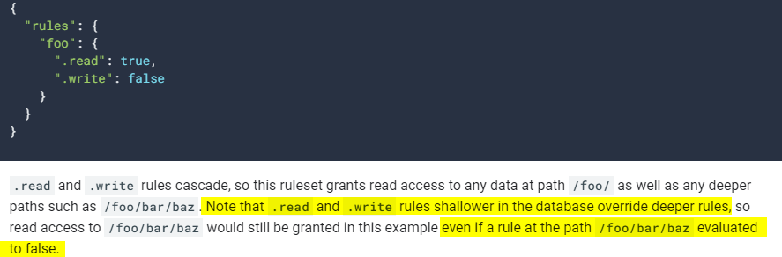
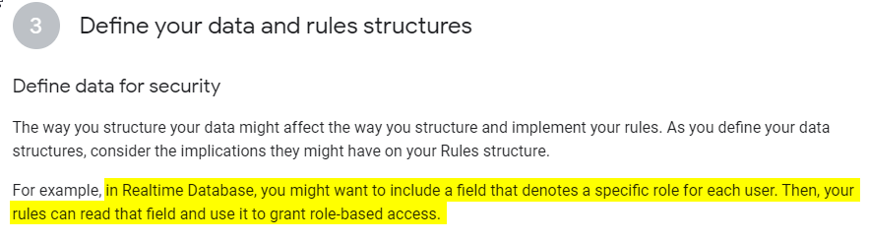
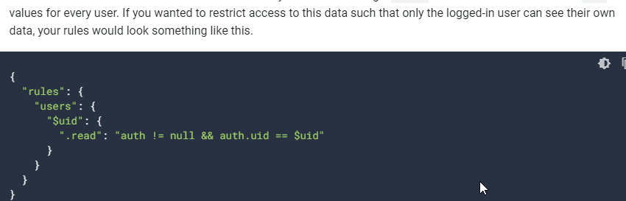
Rules Syntax
Understand Firebase Realtime Database Rules | Firebase Documentation (google.com)

Slide 64
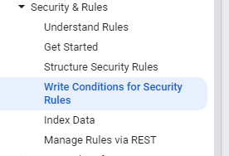
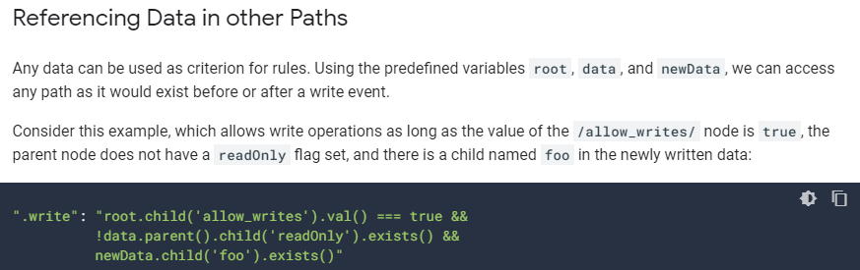
Referencing Data in Other Paths
Use conditions in Realtime Database Rules | Firebase Documentation (google.com)

Slide 65
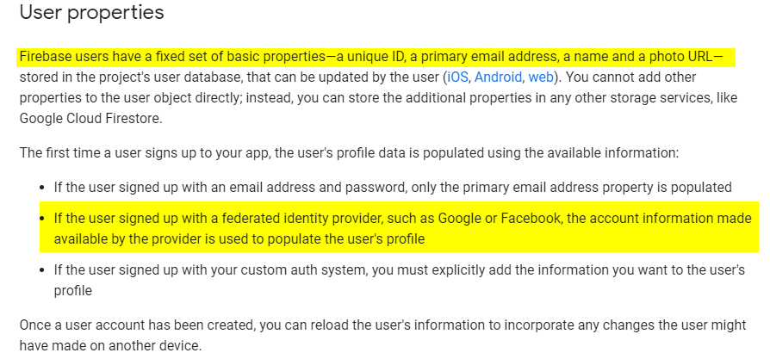
What a User Object Contains
Users in Firebase Projects | Firebase Documentation (google.com)

Slide 66
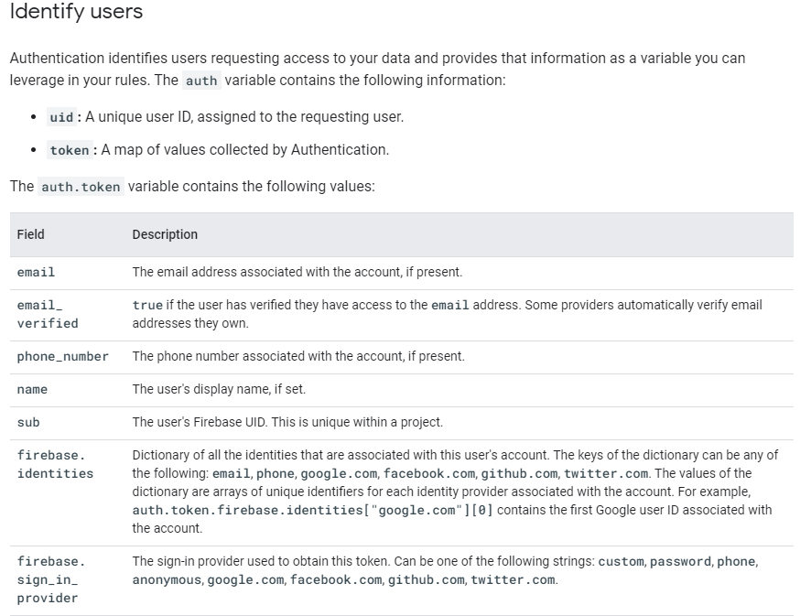
What a User Object Contains
Security Rules and Firebase Authentication | Firebase Documentation (google.com)

Slide 67
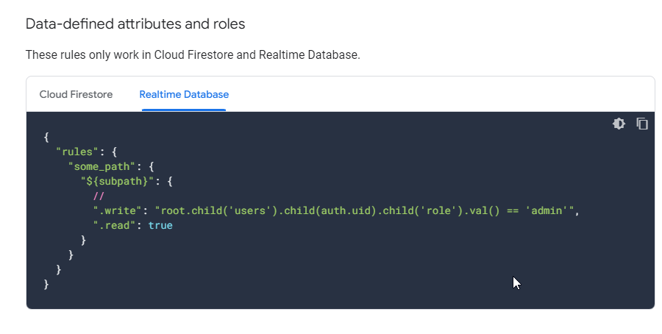
Basic Security Rules | Firebase Documentation (google.com)

Slide 68
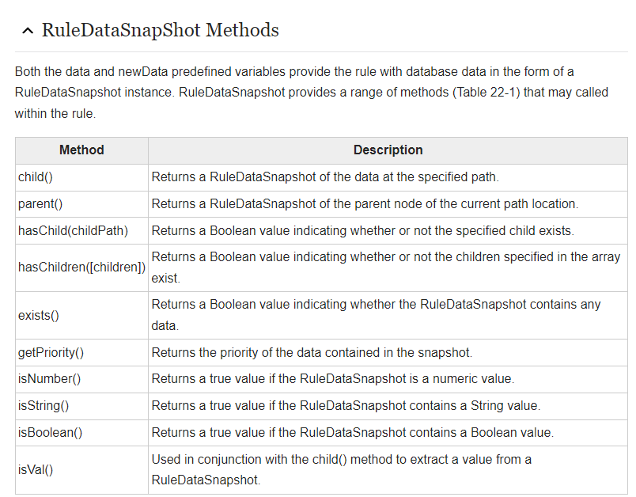
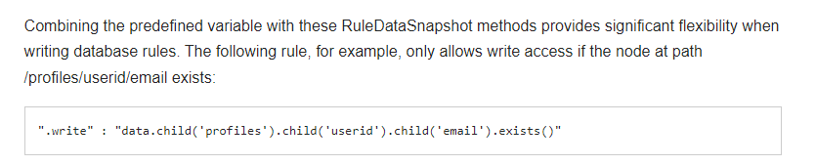
Firebase Realtime Database Rules - Techotopia

Slide 69
Disconnection

Slide 70
Hide “connection lost” pop up, continue
reconnected
Short outage, same game in progress
(GameID: 4345)
disconnected
Player in game
UID: 2354235
Status: InGame
GameID: 434
Status: Disconnected
Long outage, new game has started or old game has finished
(GameID: 233)
Move user to “there is a game in progress, what would you like to do?” page
Status: Spectating etc.
GameID: -1111
When a game is not in progress, GameID = 000

